Slide 1
Big Man Tyrone presents:
Big Man Asteroids
Aleksi, Joakim and Leo

Slide 2
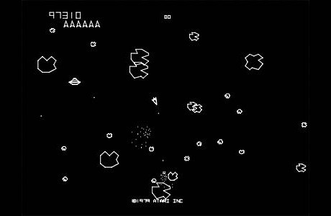
Mechanics
Our aim is to create a top down shooter game much like the classic asteroids.
Left/right buttons to rotate our ship, up/down to accelerate/deccelerate, and then shooting projectiles with the shoot key.

Slide 3
Extended Features
“Intelligent” enemies that shoot back as well as variety in AI
Large map for open world style game with objectives scattered around the map.
Aiming with the mouse
Destructible terrain/ship parts
Larger bosses that are more difficult than normal enemies
Upgrades

Slide 4

Theme
Our game will be set in a sci-fi setting
Set in the year 2154
Humanity has not found extraterrestrial intelligence... yet

Slide 5
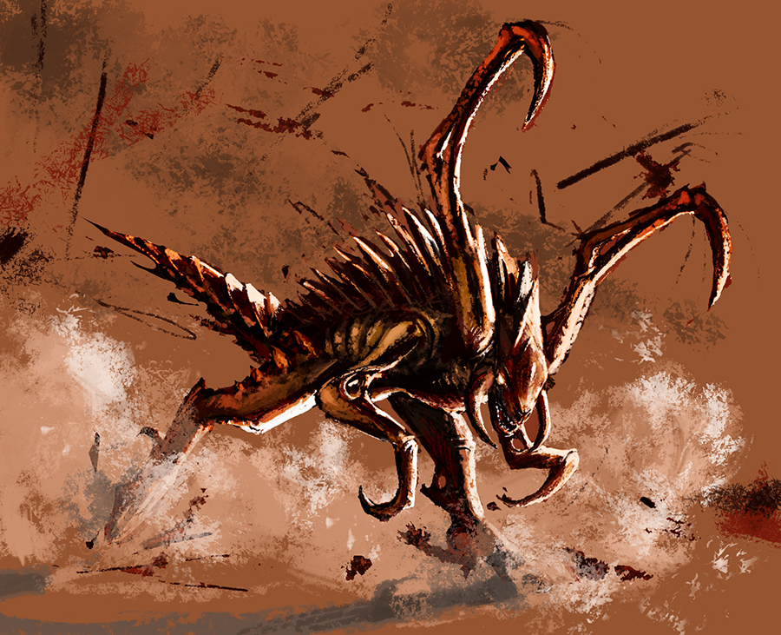
Story
You are part of the 2nd wave of colonists arriving at star system Ortega . After 50 years traveling through interstellar space, you awake from hibernation to find the 1st colonists missing.
You are given command of a ship, and must explore the system looking for clues of the 1st colonists and any threats that may endanger your own colony mission at hand.
Story told through quests and dialogue

